Slide 1
BANKING APPLICATION
SUBMITTED BY
P.PRIYANKA
BATCH CODE
2021-6139

Slide 2
ABSTRACT
program accepts the number of customers we need to add and adds the customer and account details accordingly. Further, it displays the series of menus to operate over the accounts.

Slide 3
MODULES
The series of menus displayed are as follows:
Display all account details
Search by account number
Deposit the amount
Withdraw the amount
Exit

Slide 4
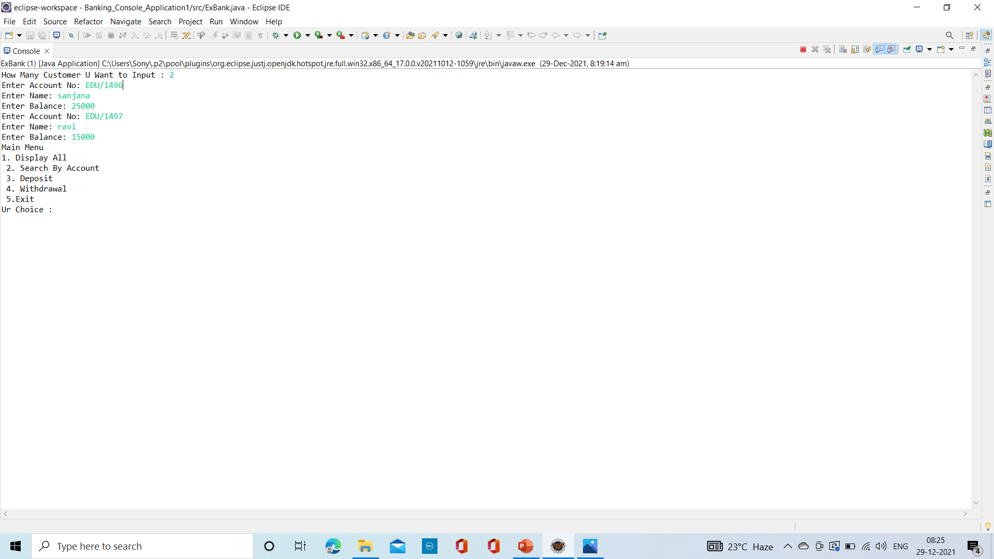
OUTPUT SCREEN

Slide 5
THANK YOU

